Slide 1
SALES REPORTING AND INITIAL REGISTRATION OF MOTOR VEHICLES
Certificate of Stock Report
Appropriate Insurance Certificate of Cover (Third Party Liability)
Philippine National Police - Highway Patrol Group (PNP-HPG) Motor Vehicle (MV) Clearance Certificate and Special Bank Receipt (SBR)
Notarized Affidavit of Undertaking stated therein that all scanned copies are authentic reproduction of the original
LTO Client/Business ID
Presentation of the original and submission of one (1) copy of any issued ID with photo and signature of client;

Slide 2
RENEWAL OF MOTOR VEHICLE (MV) REGISTRATION
Official Receipt/Certificate of Registration OR/CR (for initial renewal in MVIRS only) not applicable for online renewal
Insurance
Electronically Authenticated Insurance Certificate of Cover (COC)
Certificate of Cover (COC) issued by GSIS, if interconnectivity is not yet available (for government vehicles)
Inspection
Electronically transmitted Motor Vehicle Inspection System Report (MVISR)
Motor Vehicle Inspection Report (MVIR) not applicable for online renewal
Electronically transmitted Certificate of Emission Compliance (CEC)

Slide 3
For Hire
Franchise Confirmation
Electronically transmitted franchise
Certified Copy of the valid Motorized
Tricycle Operator’s Permit with Official Receipt
(MTOP) (For Tricycles only)

Slide 4
Reactivation of Storage
Receipt of Return Plate and Licenses (RRPL)
If For-Hire
Confirmation of Valid Franchise
Motorized Tricycle Operator's Permit (MTOP) with valid Official Receipt (OR)
Presentation of original and submission of one (1) photocopy of

Slide 5
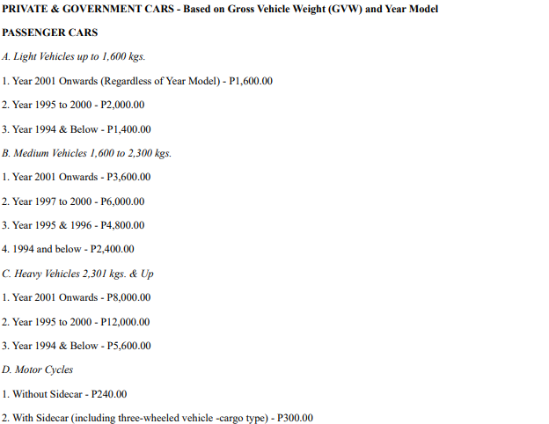
Formula / Schedule of Fees

Slide 6

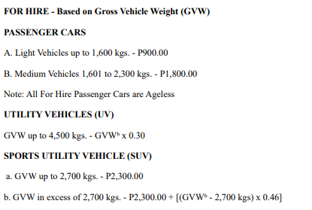
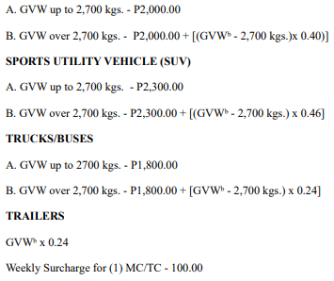
Formula / Schedule of Fees

Slide 7
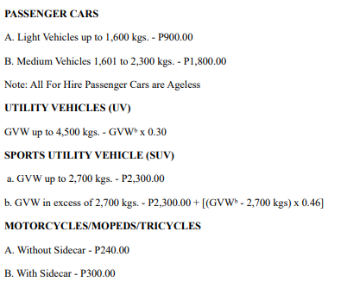
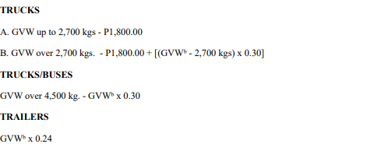
Formula / Schedule of Fees

Slide 8
MISCELLANEOUS REGISTRATION TRANSACTIONS - TRANSFER OF OWNERSHIP
Philippine National Police - Highway Patrol Group (PNP-HPG) Motor Vehicle Clearance
Duly accomplished Motor Vehicle Inspection Report
Proof of electronically transmitted appropriate insurance Certificate of Cover (Third Party Liability)
Deed Of Sale

Slide 9
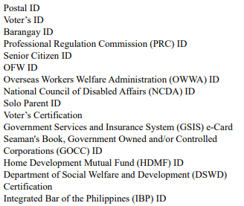
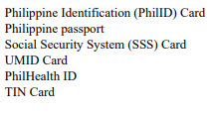
MISCELLANEOUS REGISTRATION TRANSACTIONS - TRANSFER OF OWNERSHIP
Presentation of an original copy and submission of a photocopy of any valid Government issued ID of the vendor and vendee

Slide 10
MISCELLANEOUS REGISTRATION TRANSACTIONS - TRANSFER OF OWNERSHIP
Confirmation of Certificate of Registration (CR) If issued by another agency outside the Regional Office
Board Resolution and Secretary's
Certificate indicating authority of signatory to sell or dispose the motor vehicle (If registered under the name of partnership/sole proprietorship or Corporation/ Organization)

Slide 11
Motor Vehicles acquired through a Sheriff’s Certificate of Sale issued under an Extra-Judicial Foreclosure Sale
Sheriff’s Certificate of Sale
Cancellation of Chattel Mortgage duly stamped and signed by the Registry of Deeds
Certificate of Registration - Encumbered (CRE)
Certification that the original copy was not turned over at the time of sale

Slide 12
Motor Vehicles acquired through a Sheriff’s Certificate of Sale through a Judicial Foreclosure Sale
Sheriff’s Certificate of Sale
Cancellation of Chattel Mortgage duly stamped and signed by the Registry of Deeds
Certificate of Registration - Encumbered (CRE)
Certification that the original copy was not turned over at the time of sale

Slide 13
Motor Vehicles acquired through Sheriff’s Certificate of Sale Pursuant to a Money Judgment which has become final and executory
Sheriff’s Certificate of Sale
Cancellation of Chattel Mortgage duly stamped and signed by the Registry of Deeds
Certificate of Registration - Encumbered (CRE)
Certification that the original copy was not turned over at the time of sale

Slide 14
Private Motor Vehicles / Motor Cycles
Deed of Sale / Transfer / Conveyance
Original Certificate of Registration Certificate of Registration

Slide 15
Motor Vehicles acquired through public bidding conducted by government office/entity
Certificate of Sale/Notice of Award
Inventory and Inspection Report
Official Receipt of payment
Certificate of Registration (CR)

Slide 16
Motor Vehicles acquired at public auction before a notary public by virtue of a mechanic’s lien
Certificate of Sale
Affidavit who conducted the public bidding as proof of compliance to the above requirements
Certificate of Registration (CR)

Slide 17
Motor Vehicles acquired through Extra-Judicial Settlement of Estate of Deceased Person
Certificate of Registration (CR)
Affidavit of publication of the Deed in any newspaper of general circulation for three (3) consecutive weeks with clippings
Death Certificate, Birth Certificate and/or Marriage Certificate
Presentation of original and submission
of a photocopy of any valid Philippine
Government issued ID

Slide 18
Motor Vehicles acquired through Judicial Settlement of Estate of Deceased Person
Certificate of Registration (CR) or affidavit of loss
Court Decision
Death Certificate, Birth Certificate and/or Marriage Certificate
Presentation of the original copy and submission of a photocopy of any Philippine government issued ID

Slide 19
Motor Vehicles acquired through Public Bidding conducted by Land Transportation Office under Presidential Decree No. 1729
Inventory and Inspection Report
Approved Committee Resolution
Notice of Award and Certificate of Sale
Official Receipt of Payment
Registry Receipt of Registered Mail

Slide 20
Government -owned vehicles to another government office
Certificate of registration (CR)
Deed of Sale / Transfer / Conveyance

Slide 21
Miscellaneous Registration Transactions - Annotation of Mortgage and other liens or Encumbrances
A.
Annotation of Mortgage and other Liens or Encumbrances
Duly annotated chattel mortgage contract with Official Receipt (OR) duly stamped and signed
B.
Cancellation of Mortgage or other Liens and Encumbrances

Slide 22
Miscellaneous Registration Transactions - Annotation of Mortgage and other liens or Encumbrances
Certificate of Registration – Encumbered (CRE) cancellation or release of Chattel Mortgage duly stamped and signed by the Registry of Deed
Official Receipt (OR) of recording fee
Duly accomplished Motor Vehicle Inspection Report

Slide 23
Cancellation of Mortgage when the financing company (mortgagee) no longer exists and the release Mortgage Contract is missing
Certificate of Registration – Encumbered (CRE)
Affidavit of Undertaking
Certification stating that the financing company is no longer in existence
Surety Bond based on the fair market value of the motor vehicle valid for one (1) year
Affidavit of Publication

Slide 24
MISCELLANEOUS REGISTRATION TRANSACTIONS - CHANGE CLASSIFICATION
Proof of electronically transmitted appropriate insurance Certificate of Cover (Third Party Liability)
Duly accomplished approved Motor Vehicle Inspection Report
Certificate of Registration (CR)
certification that the original Certificate of Registration - Encumbered (CRE) is with the financing company and that it interposes no objection on the application for change classification (Private to For Hire)

Slide 25
For Hire to Private
Dropping Order
Certificate of Registration (CR)
Return of Plate

Slide 26
Private to Government
Deed of Sale/Deed of Donation and Acceptance/Seizure Order or Forfeiture Order
Philippine National Police – Highway Patrol Group (PNP-HPG) Motor Vehicle Clearance Certificate
Presentation of original and submission of one (1) photocopy of any of the following valid Philippine government issued ID of the transferer and transferee

Slide 27
Private to Government
Private Plate
Certificate of Payment (if applicable)
SEC/DTI Certificate

Slide 28
Government to Private
Certificate of Registration (CR)
Notice of Award
Inventory and Inspection Report
Receipt of Bid Payment
Surrender Red Plate
Philippine National Police – Highway Patrol Group (PNP-HPG) Motor Vehicle Clearance Certificate

Slide 29
MISCELLANEOUS REGISTRATION TRANSACTIONS - CHANGE BODY/BODY DESIGN/ENGINE/COLOR
Certificate of Registration (CR) / Certificate of Registration - Encumbered (CRE) with SEC Certificate
Philippine National Police - Highway Patrol Group (PNP-HPG) Motor Vehicle Clearance Certificate (except for Motorcycle with sidecar)
Proof of Electronically transmitted appropriate insurance Certificate of Cover (Third Party Liability)

Slide 30
MISCELLANEOUS REGISTRATION TRANSACTIONS - CHANGE BODY/BODY DESIGN/ENGINE/COLOR
Duly accomplished Motor Vehicle Inspection Report (MVIR)
For Situational Requirement
Affidavit of Change Body/Body Design indicating source of body
Sales Invoice / Certificate of Registration (CR) of the source of body
If For-Hire
LTFRB Confirmation

Slide 31
MISCELLANEOUS REGISTRATION TRANSACTIONS - CHANGE BODY/BODY DESIGN/ENGINE/COLOR
Change Color
Affidavit of Change Color
Change Engine
Certificate of Stock Reported (CSR) and Sales Invoice / Certificate of Registration (CR) of the source of engine
Deed of Sale/Deed of Donation of engine if sourced from previously registered motor vehicles acquired from different persons or entities
Joint Affidavit of Change Engine

Slide 32
MISCELLANEOUS REGISTRATION TRANSACTIONS - DUPLICATE CERTIFICATE OF REGISTRATION / CERTIFICATE OF REGISTRATION - ENCUMBERED
Affidavit of Lost Certificate of Registration (CR) (If encumbered, to be executed by the Financing institution)
Duly accomplished Motor Vehicle Inspection Report (MVIR)
Presentation of original and submission of one (1) photocopy of any of the following valid Philippine government issued ID

Slide 33
MOTOR VEHICLE INSPECTION
Official Receipt (OR) / Certificate of Registration (CR)
A.
Official Receipt (OR) / Certificate of Registration (CR)
A.1. If for hire
Certificate of Public Convenience
Order for dropping and substitution

Slide 34
STORAGE OF MOTOR VEHICLE
Certificate of Registration (CR)
Affidavit of Loss
Motor Vehicle / Motorcycle plate
Certification

Slide 35
REQUEST FOR MOTOR VEHICLE VERIFICATION
Request from Authorized Government Agency
Letter Request
Support Legal Documents
Any issued ID with Photo and Signature of the Requesting Party and the Motor Vehicle Owner

Slide 36
REQUEST FOR DATA TAKE-ON (thru email)
Duly accomplished original Data Take-On (DTO) Form
Initial Certificate of Registration (CR) and latest Official Receipt (OR)
Duly accomplished original Motor Vehicle Inspection Report (MVIR) (latest) and Official Receipt (OR)
Sales Invoice
Stock Report (CSR) or Confirmation Certificate

Slide 37
REQUEST FOR DATA TAKE-ON (thru email)
Philippine National Police - Highway Patrol Group (PNP-HPG) Clearance
Government issued ID with photo and signature of the owner
Confirmation reply

